Slide 1

Mid Project MPS 18 Months Instructed by: Eng. Mohab Allam
Academic & Analytical Presentation
Ahmed Abdelaal El-hoot, B.Eng , MBA

Slide 2

Section 1 Data Understanding
Understand what each column is representing.
The Challenge: The organization lacks a reliable data-driven forecast model for managing demand and supply over an 18-month planning horizon.
The Consequences: This leads to inefficient resource allocation, stock shortages or overstock, and suboptimal operational planning.
The Objective: To build an interactive, predictive system using Python and Streamlit that leverages historical data for smarter decision-making and improved forecasting accuracy.

Slide 3
Attribute Information
PLN-MM/YY | Planning period (e.g., 202310 = October 2023).
Sales_Doc. | Unique identifier for sales document.
Item | Line item number within the sales document.
V | Likely a concatenated or encoded field (e.g., Sales Doc + Item = V).
Loaded_line | Line status code values like CR, PP (might refer to process types).
New_Plan | Text version of planning month (e.g., "2024 Jan").
Sold_to_party | Customer name in Arabic or English.
Country_Key | Country (mostly "Egypt" in sample).
Destination | Final customer destination category (e.g., "Local").
Material | Product code (e.g., CRCF, POCF).
CUST_THICKNESS | Customer-requested thickness (in mm likely).
CUST_WIDTH | Customer-requested width (in mm likely).
KS_GRADE01 | Product grade (e.g., DC01, DX51D).
ZINC01 | Zinc coating (values like 80, 120, 180; may be missing if not applicable).
Remain_GRF | Remaining quantity or planning figure (possibly in tons or tons-equivalent).
Destination | Sub-destination or business segment (e.g., Corporate, Service Center).
Creation | Incoterm (e.g., EXW, CPT – terms of delivery).
CBE$ | Some cost or price per unit (As per Central Bank of Egypt Exchange Rate, in USD).
BM$ | Some cost or price per unit (As per Black Market Exchange Rate, in USD).

Slide 4
Section 2 Import Necessary Libraries
numpy
pandas
jupyterlab
notebook
plotly
streamlit
pipreqs

Slide 5
Section 3: Data Loading

Slide 6
Section 4: Data Exploration
Overview about the data
Check Data Types
Some Columns Type Conversion
Check Summary Statistics for Numerical Columns
Check Summary Statistics for Categorical Columns
Check Duplicates
Check Missing Values

Slide 7
Section 5: Data Cleaning
In-Depth Check For each Column
Check of Unique Values
Some Values Unifications
Some Histograms Overview

Slide 8
Section 6: Feature Engineering
Any feature can help in analysis or what are most-related columns to the target Column
Demanded Month Separation from Year
Plan Month Separation from Year
Unification of Months Form
Order Item Type

Slide 9
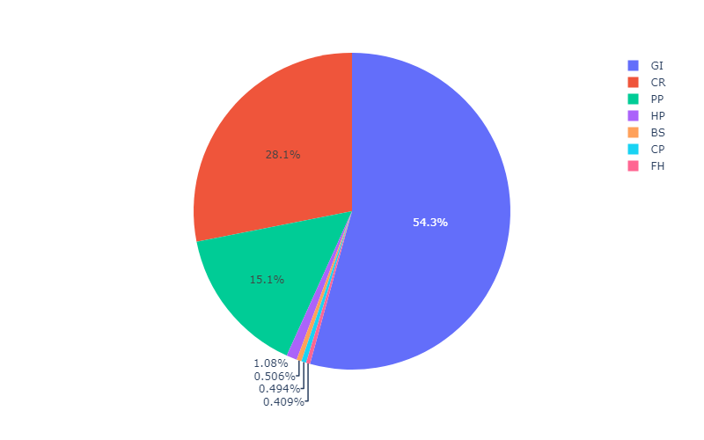
Section 7: Data Analysis
What is the percentage of each product in the data ?

Slide 10
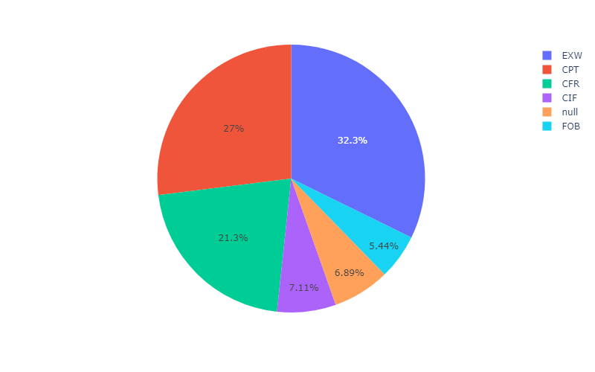
Section 7: Data Analysis
What is the percentage of each Incoterm in the data ?

Slide 11
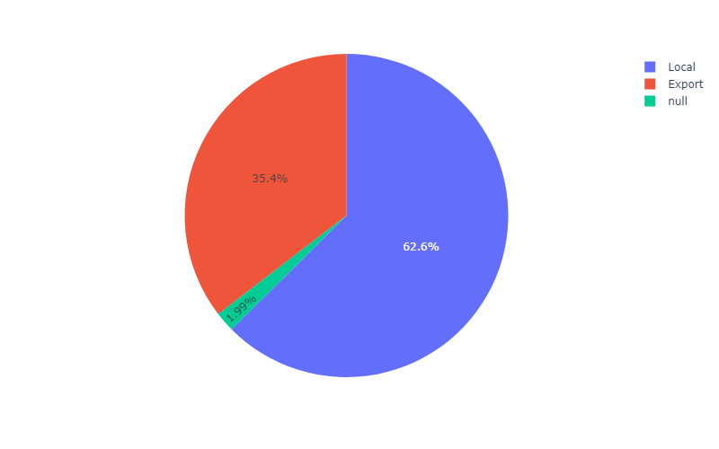
Section 7: Data Analysis
What is the percentage of each Destination (Export/Local) in the data ?

Slide 12
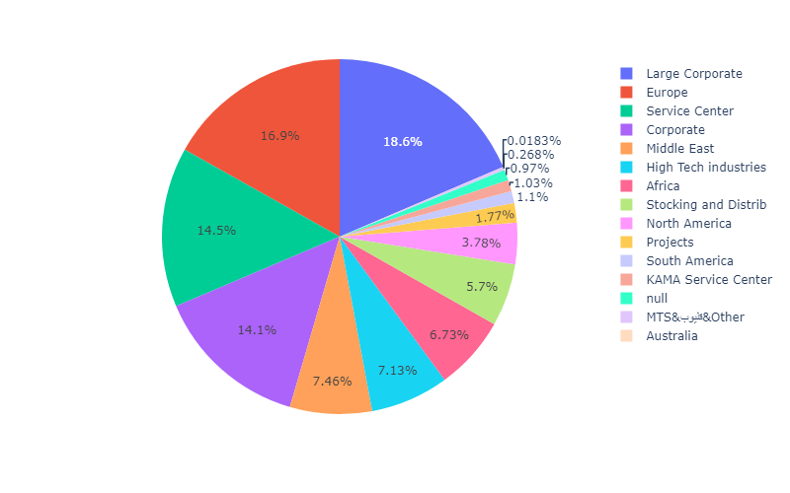
Section 7: Data Analysis
What is the percentage of each Destination (Detailed) in the data ?

Slide 13
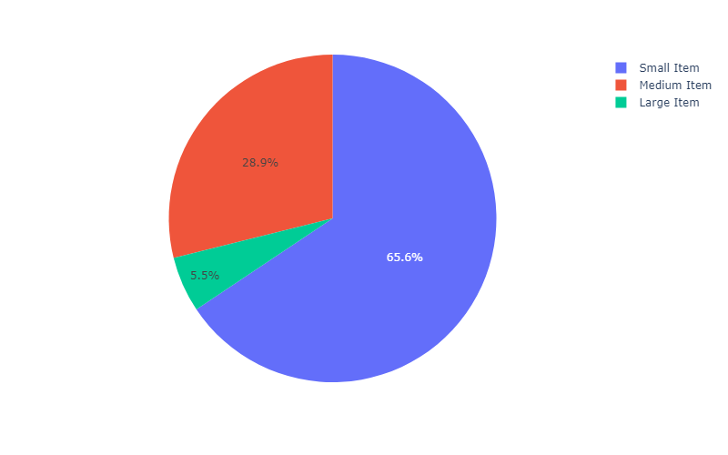
Section 7: Data Analysis
What is the percentage of each Order Item Size in the data ?

Slide 14
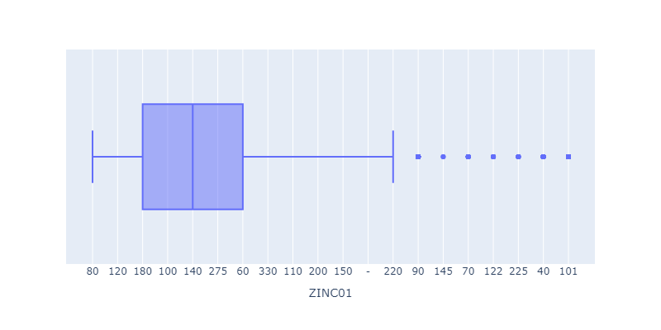
Section 7: Data Analysis
What is the Box-Plot status of Zinc Weight in the data ?

Slide 15
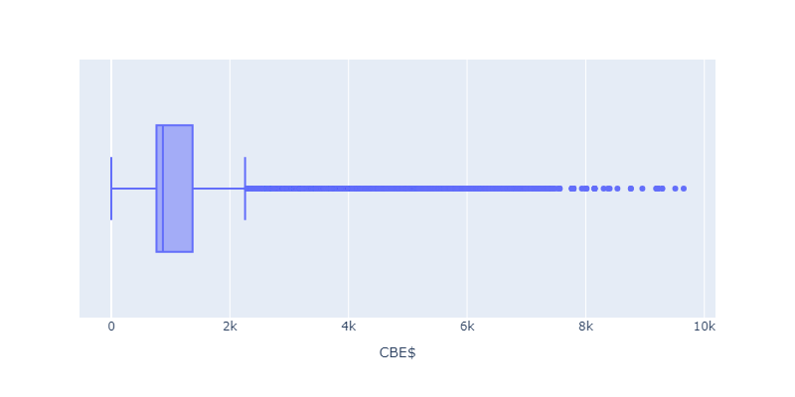
Section 7: Data Analysis
What is the Box-Plot status of CBE $ in the data ?

Slide 16
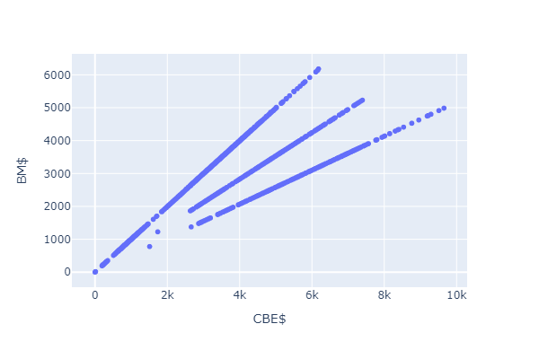
Section 7: Data Analysis
What is the relation between CBE $ and BM $ in the data ?

Slide 17
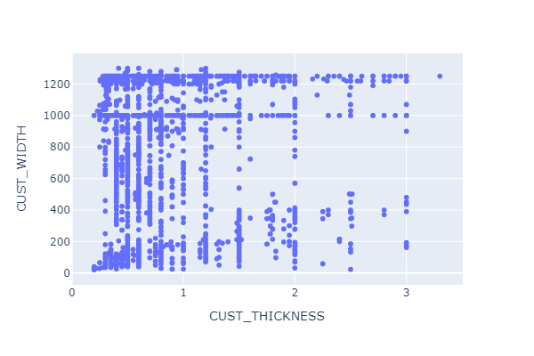
Section 7: Data Analysis
Is there a relation between CUST_THICKNESS and CUST_WIDTH in the data ?

Slide 18
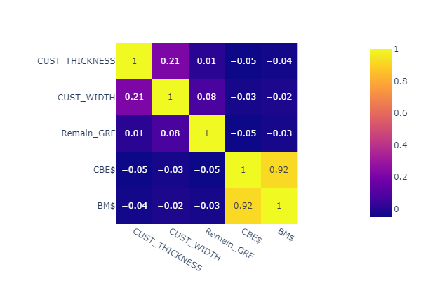
Section 7: Data Analysis
What is the correlation bwetween all Numerical Values ?

Slide 19
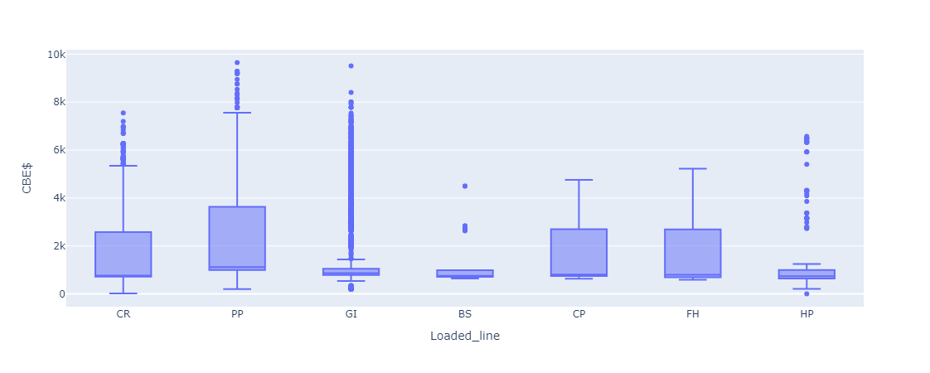
Section 7: Data Analysis
The Box-Plot Comparison between Every Loaded line as per CBE $ in the data ?

Slide 20
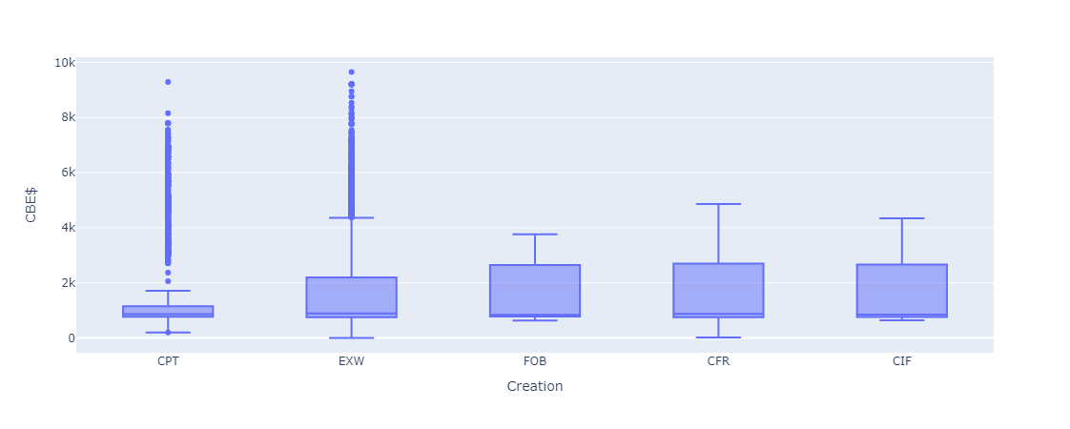
Section 7: Data Analysis
The Box-Plot Comparison between Every Incoterm as per CBE $ in the data ?

Slide 21
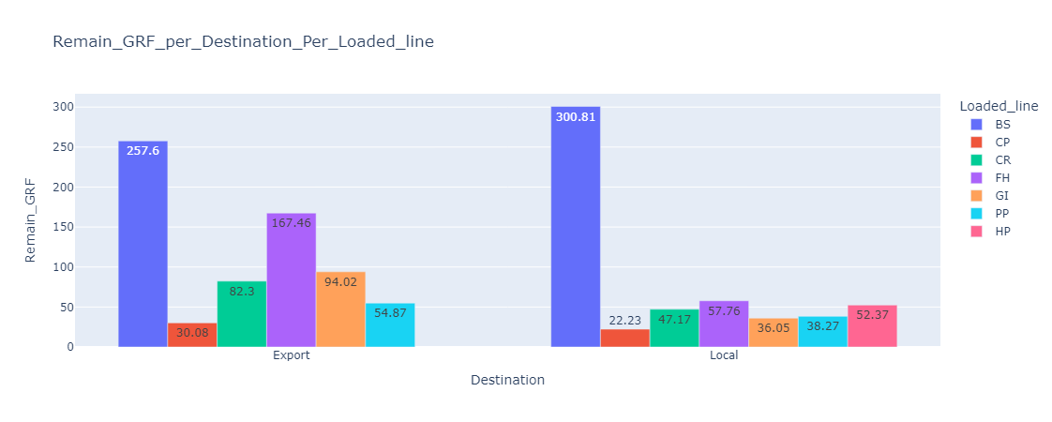
Section 7: Data Analysis
The Bi-Bar Chart Comparison between Destination and Loaded Line in the data, AVG Base?

Slide 22
General Challenges plotly colors
import plotly.io as pio
pio.templates.default = "plotly"

Slide 23
General Challenges astype
cols_to_convert = ['PLN-MM/YY', 'Sales_Doc.', 'Item', 'V']
df[cols_to_convert] = df[cols_to_convert].astype(object)

Slide 24
General Challenges Typo
def clean_loaded_line(x):
if x == 'pp’: return 'PP'
if x == 'FB’: return 'FH'
else: return x
df.Loaded_line df.Loaded_line.apply(clean_loaded_line)

Slide 25
General Challenges Month Unification
df['Demanded_Month'] = df['PLN-MM/YY'].astype(str).str[4:6]
month_map = {'01': 'Jan', '02': 'Feb', '03': 'Mar', '04': 'Apr',
'05': 'May', '06': 'Jun', '07': 'Jul', '08': 'Aug',
'09': 'Sep', '10': 'Oct', '11': 'Nov', '12': 'Dec'}
df['Demanded_Month'] = df['Demanded_Month'].map(month_map) df['Demanded_Month']

Slide 26
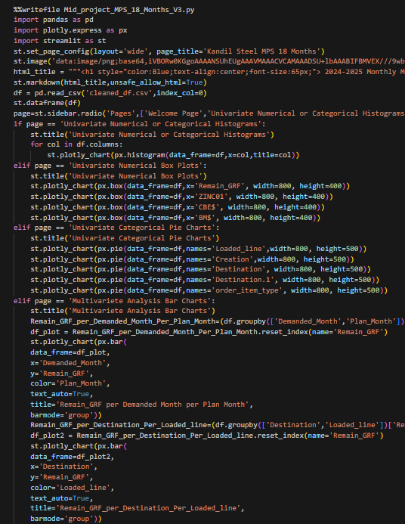
Section 8: Deployment
Releasing written code into a live environment so users can access and use it.

Slide 27

Section 8: Deployment
The interactive web application is available at Streamlit
It demonstrates the project's model, interactivity, and UI.
Link Here

Slide 28
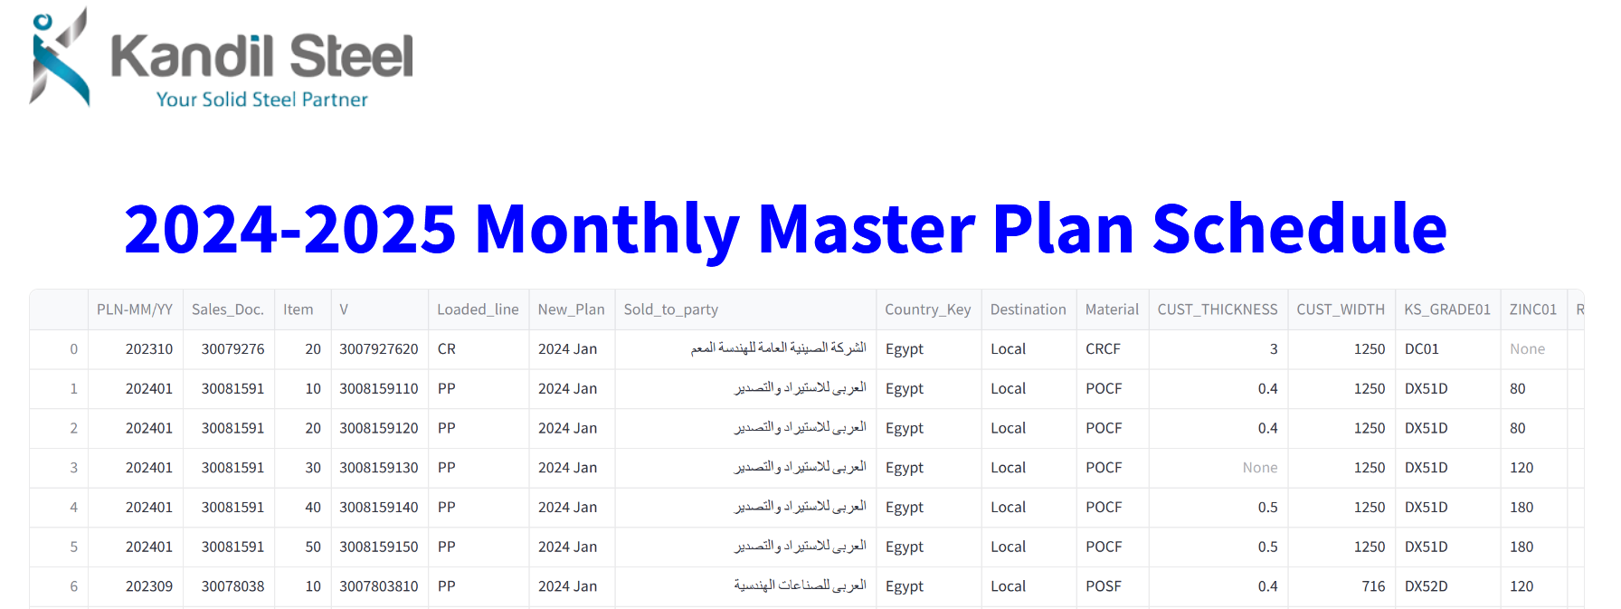
Streamlit

Slide 29
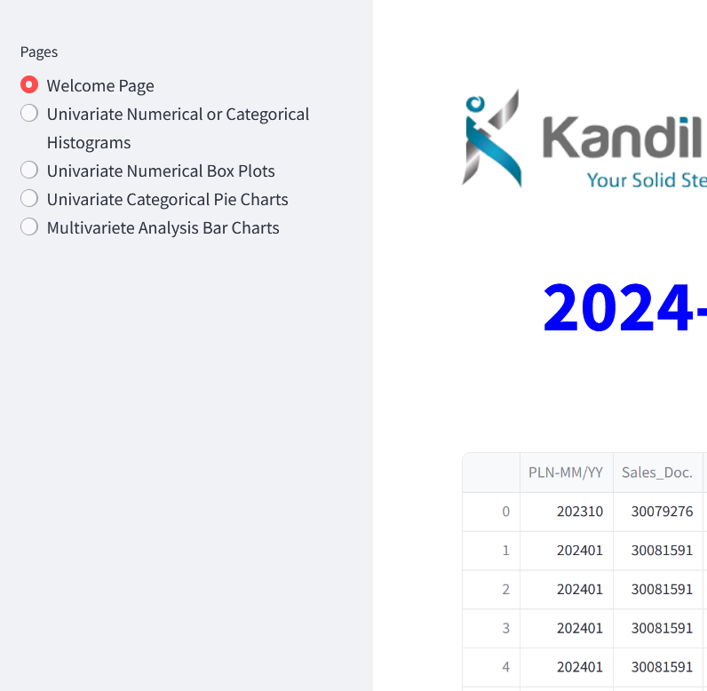
Streamlit

Slide 30
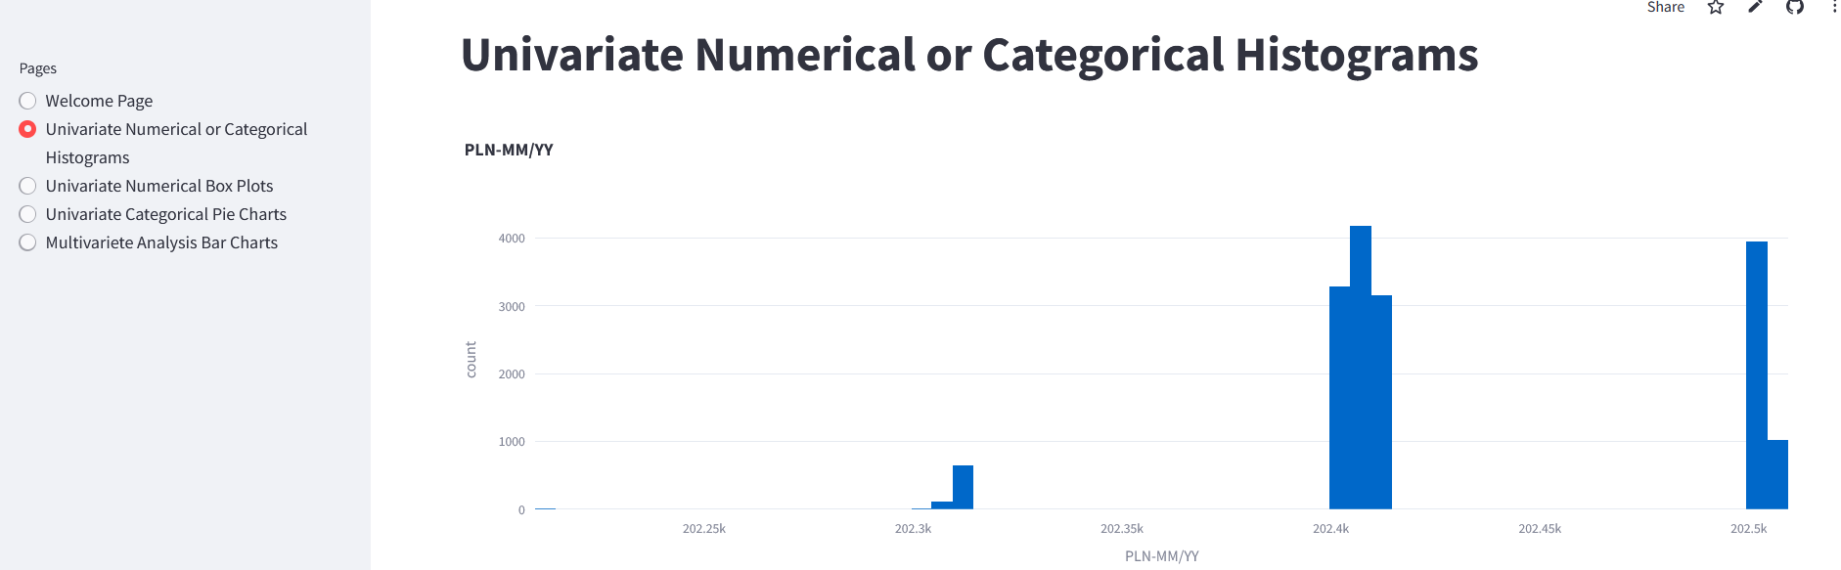
Streamlit

Slide 31
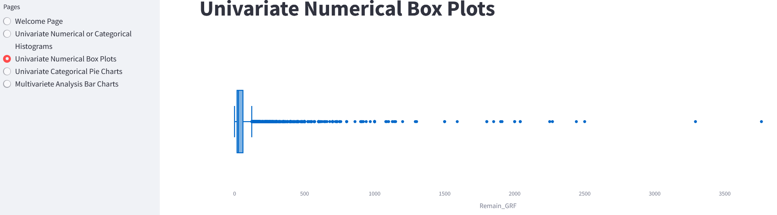
Streamlit

Slide 32
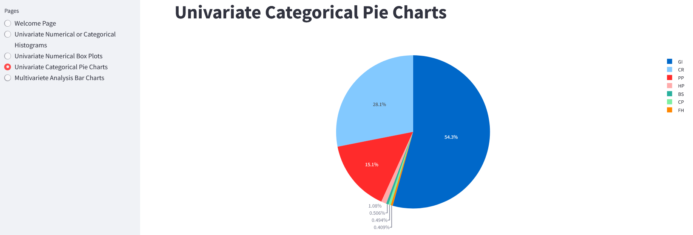
Streamlit

Slide 33
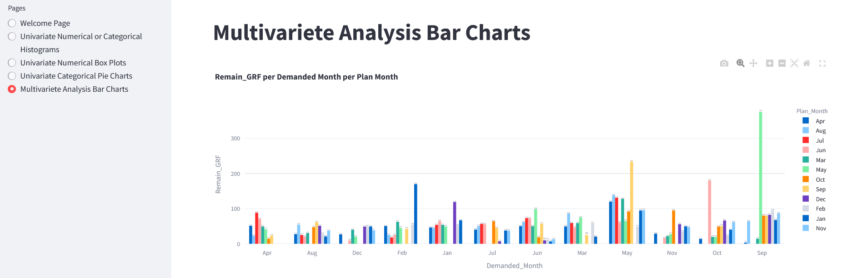
Streamlit

Slide 34
Thanks

